Slide 1

Financial Status Report VA Form 5655 and Notice of Rights and Obligations
Raphel Rauer
Robert Shepard

Slide 2
VA Top Priorities
Provide Veterans with the benefits they have earned in a manner that honors their service
Ensure we are strong fiscal stewards of the money entrusted to us while aggressively advocating on behalf of Veterans
Foster a culture of collaboration

Slide 3
Because I CARE, I will…
INTEGRITY
COMMITMENT
ADVOCACY
RESPECT
EXCELLENCE
Act with high moral principle. Adhere to the highest professional standards. Maintain the trust and confidence of all with whom I engage.
Work diligently to serve Veterans and other beneficiaries. Be driven by an earnest belief in VA’s mission. Fulfill my individual responsibilities and organizational responsibilities.
Be truly Veteran Centric by identifying, fully considering, and appropriately advancing the interests of Veterans and other beneficiaries.
Treat all those I serve wand with whom I work with dignity and respect. Show respect to earn it.
Strive for the highest quality and continuous improvement. Be thoughtful and decisive in leadership, accountable for my actions, willing to admit mistakes, and rigorous in correcting them.

Slide 4
Financial Status Report VA Form 5655 Privacy Act Information
PRIVACY ACT INFORMATION: The information you furnish on this form is almost always used to determine if you are eligible for waiver of a debt, for the acceptance of a compromise offer or for a payment plan. Disclosure is voluntary. However, if the information is not furnished, your eligibility for waiver, compromise or a payment plan may be affected. The responses you submit are confidential and protected from unauthorized disclosure by 38 U.S.C. 5701. The information may be disclosed outside the Department of Veterans Affairs (VA) only when authorized by the Privacy Act of 1974, as amended. The routine uses for which VA may disclose the information can be found in VA systems of records, including 58VA21/22, Compensation, Pension, Education and Rehabilitation Records-VA, and 88VA244, Accounts Receivable Records-VA. VA systems of records and alterations to the systems are published in the Federal Register. Any information provided by you, including your Social Security Number, may be used in computer matching programs conducted in connection with any proceeding for the collection of an amount owed by virtue of your participation in any benefit program administered by VA.

Slide 5
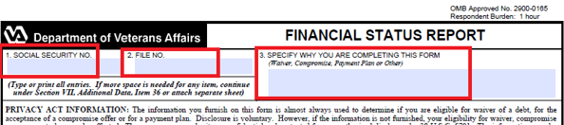
Financial Status Report (FSR VA Form 5655)
Confirm VA file and SSN number. The number is printed in the upper right-hand corner of most letters from Debt Management Center. In most cases, this may be a social security number.
Why is this from being completed? Check Block 3, see what is being specified or requested?
Make sure that what is being requested is processed in the order of precedence whether is a Dispute, Compromise, Waiver, Payment Plan or Other

Slide 6
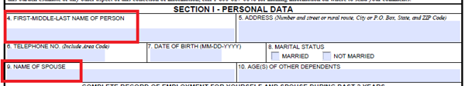
Financial Status Report (FSR VA Form 5655) Section 1 – Personal Data
4. Whose name goes in Section I – Personal Data, Block 4?
- The debtor’s name should be placed in Block 4 even if debtor is not the veteran.
5a. This has nothing to do with their spouse. Do I need to include his/her income?
- Yes. Spouse must be listed to consider total household income and determine their ability to pay and the
amount they can afford to pay monthly.

Slide 7
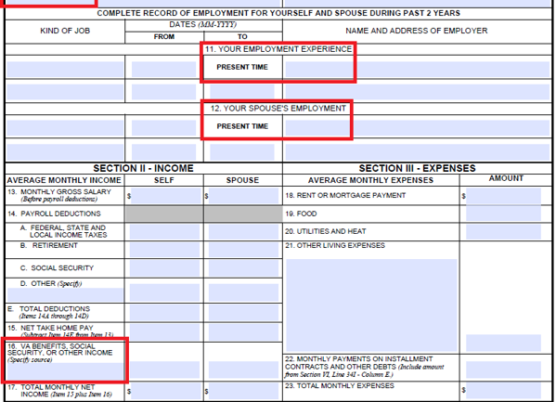
Financial Status Report (FSR VA Form 5655) Sections I & 2 – Employment, Income & Expenses
5b. If spouse is listed do I need to include his/her income?
- Yes. We must consider total household income to determine their ability to
pay and the amount they can afford to pay monthly.
6. Do they need to send proof of income and send copies of their expenses?
- No. However, we may ask for proof of income and monthly expenses at a
later time, if we have additional questions.
7. Do they need to list their VA benefits?
- Yes. Include monthly VA benefits (compensation and/or pension),
received by them and their spouse.
8. All they receive is social security, where do they put this information?
- This information is in Section II, Block 16, Pension, Compensation, or Other
Income. Report the Medicare Deduction in Section III – Expenses.
9. They only work part-time and the hours aren’t always the same. How do I figure that on a monthly basis?
- Average the income on the monthly basis to the best of your ability. If they
supplied their tax return for last year, you can divide those reported
wages by 12 and use that amount.

Slide 8

What is the debtor offering to repay on a monthly basis towards their debt?
Income exceeds expenses – verify the amount you calculated and what is in Block 24A (Match/Not matching).
If Block 24B is left blank and you cannot determine what is being requested – send the “why” letter.
Do not be lasered focused on this box without analyzing the whole FSR and verifying if debtor is receiving any type of benefits that they may not have listed on the FSR.
Cannot approve a payment plan that is lesser than what the debtor is offering in Block 24B.
Remember Secretary’s message from the 3 pillars, “Ensure we are strong fiscal stewards of the money entrusted to us while aggressively advocating on behalf of Veterans.”

Slide 9
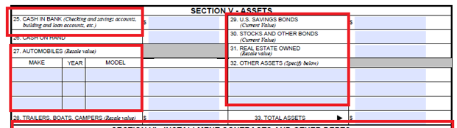
Financial Status Report (FSR VA Form 5655) Section 5 - Assets
10. Make sure items are clearly listed whether it is a car and/or home in Section V –
Assets if not owned outright
- Items listed in Section V - Assets and include
any monthly payments on those assets in
Section VI – Installment Contracts and Other
Debts.
11. What is the resale value of the car?
- Estimate amount should be listed if car payment
is noted.
Always compare the amount of Assets to the Age and Size of Debts or Accounts to Determine the Ability to Pay!

Slide 10
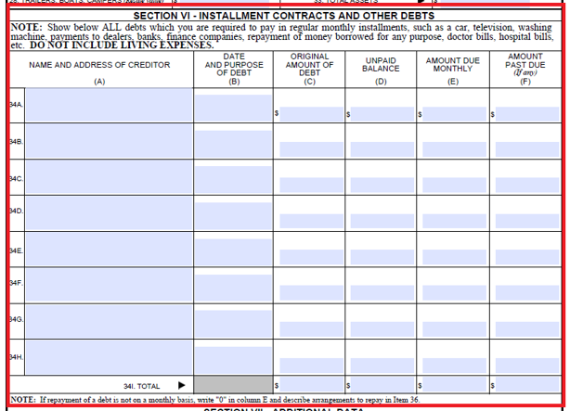
Financial Status Report (FSR VA Form 5655) Section 6 - Consumer Debts
Remember payment plans for Federal Debts require the same considerations as any other debts incurred.
Note and be cautious of the amount the Veteran or account holder is paying for in Section 3 on the front/first page for Rent or a Mortgage to include Food as well as Other Monthly Expenses.
Ensure that the total of monthly installments is reflected correctly in Section 3 of Expenses Block 22 on the front/first page.

Slide 11

Financial Status Report (FSR VA Form 5655) Section 7 - Bankruptcy
If Block 35A is checked “Yes”, DO NOT PROCESS FSR.
Review C17 notes & PEGA memo notes to determine if Bankruptcy has already reviewed and advised to continue collection process as normal.
If no C17 notes or PEGA memo notes from Bankruptcy team, please forward to Bankruptcy team to review account before any requests and collections can continue.
Even if Veteran or account holder stated they were discharged before the debt was created, forward to Bankruptcy team to make sure account can undergo normal collection processing. This ensures a positive Veteran and Employee experience.

Slide 12
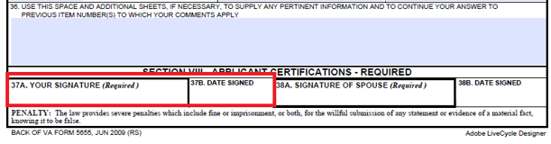
Financial Status Report (FSR VA Form 5655) Section 7 - Signatures
12. Is it necessary for them to sign the form?
- Yes. We cannot process the information on the form without a signature.

Slide 13

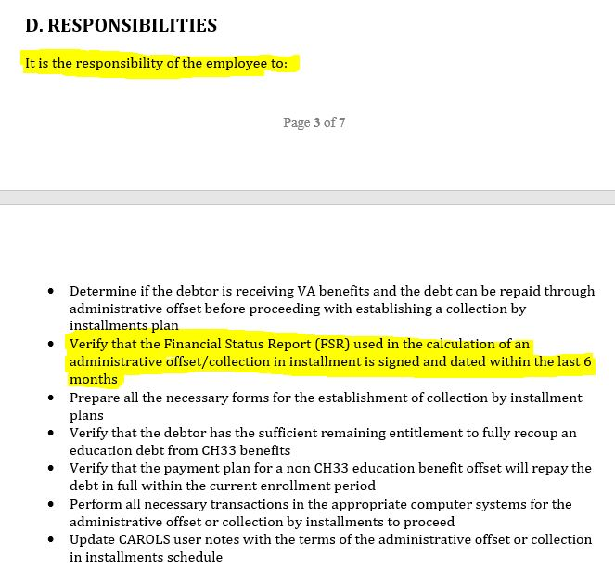
Refence of FSR in SharePoint SOP
Debts are subject to change due to increases or new debts, therefore FSRs are good for 6 months barring no change to expenses.
In SharePoint SOP Table of Contents: Admin Offsets & Collection in Installments as of May 25, 2018 under Responsibilities second bullet point:
- “It is the responsibility of the employee to:
- Verify that the Financial Status Report
(FSR) used in the calculation of an
administrative offset/collection in
installment is signed and dated within
the last 6 months.”

Slide 14
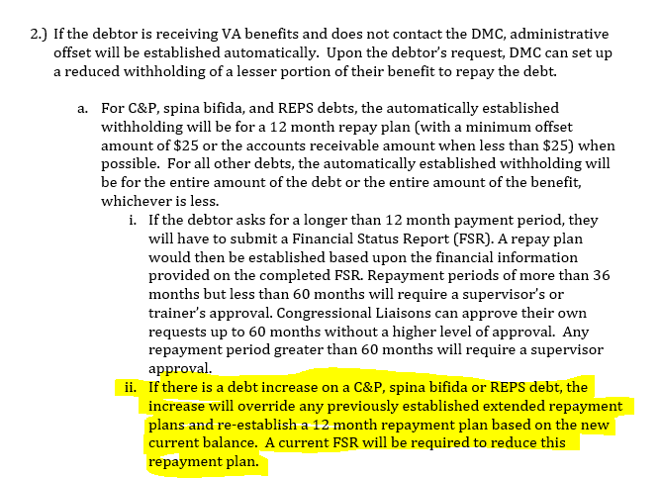
Reference of FSR in SharePoint SOP Continued
Whenever new debts or increases are added, DMC requires new FSR to see if payment plans still meets the debtors’ needs as well as the debts’ needs.
Under DMC Policy #2.a.ii. : “If there is a debt increase […], the increase will override any previously established extended payment plan and re-establish a 12 month repayment plan based on the new current balance. A current FSR will be required to reduce this repayment plan.”

Slide 15
New FSR Needed vs Not Needed
New FSR Needed
New FSR Not Needed
Debt increase and FSR on file is more than 6 months old
FSR on file is 6 months or less but there are changes to consumer expenses.
Current FSR has been used to approve an extended payment plan (more than 1 year) and debtor wants to request lower payment plan than what has been approved by a supervisor (They should include a note with new FSR to explain any additional expenses or dollar amounts that went up from previous FSR).
Debt increase and FSR on file is 6 months or less old without change to expenses.
No debt increase but we offset more than payment plan and payment plan was approved based on an FSR that was valid at the time ( example- they are on a 5 year payment plan that was properly approved by a sup per notes and debt has not increased since approval, but we somehow offset a full check- they do not need to send new FSR in this scenario)

Slide 16
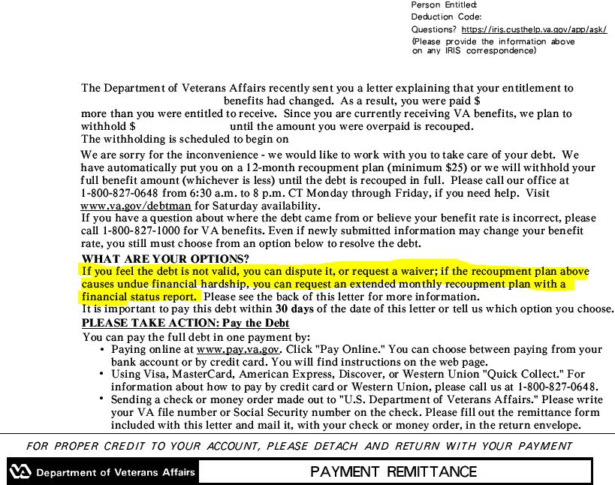
Reference of FSR Noted in 100 or 101 Letters
FSR Reference in the 100 & 101 Letter
Filling an FSR for Dispute, Waiver Request or Extended Repayment Requests

Slide 17
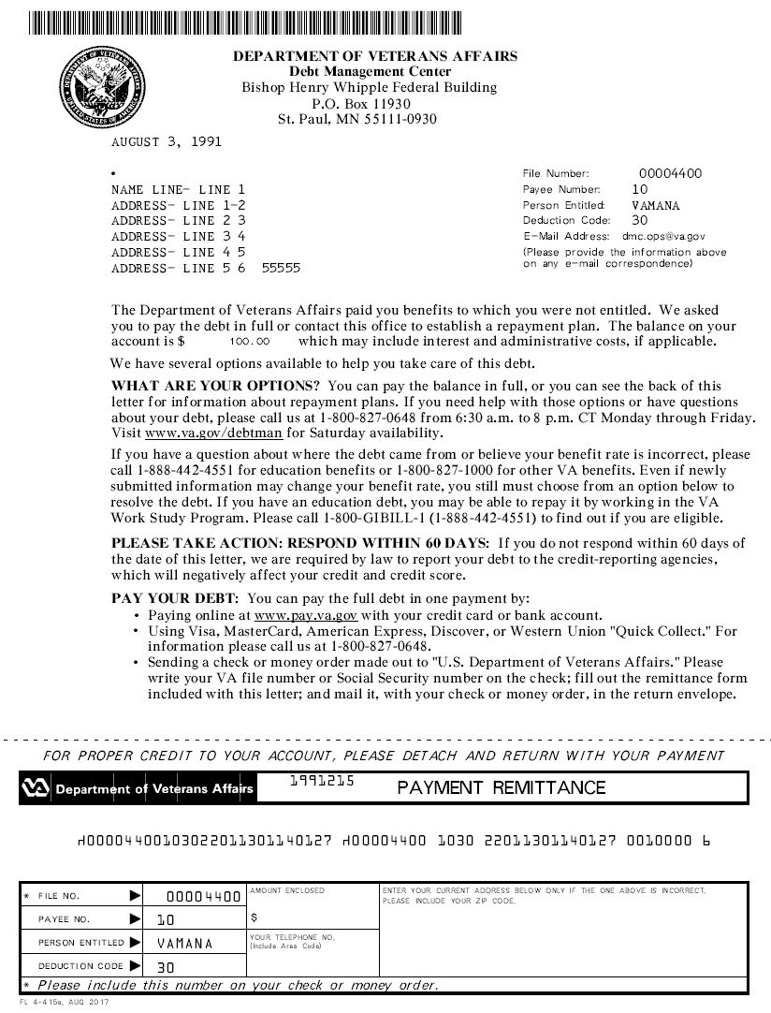
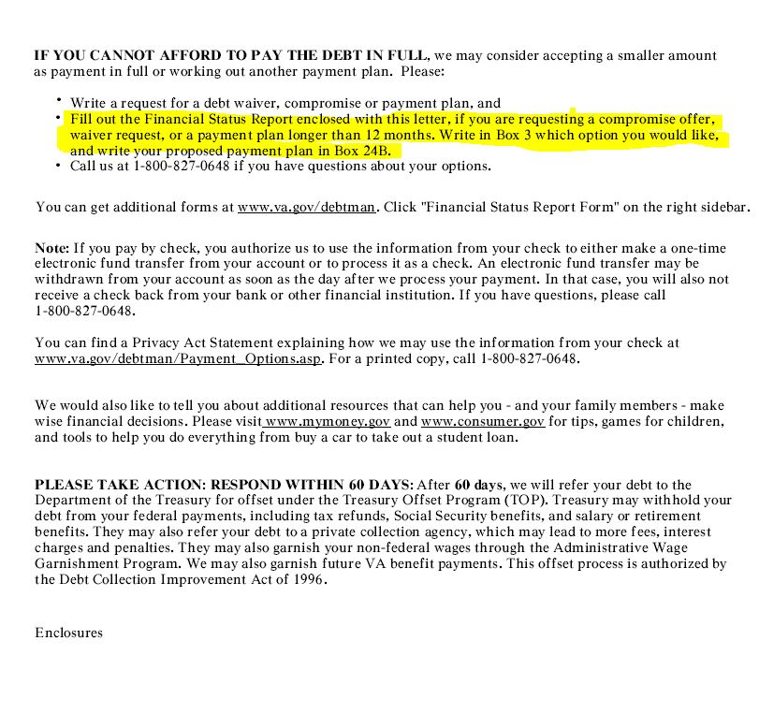
Reference of FSR Noted in 117 Letters

Slide 18
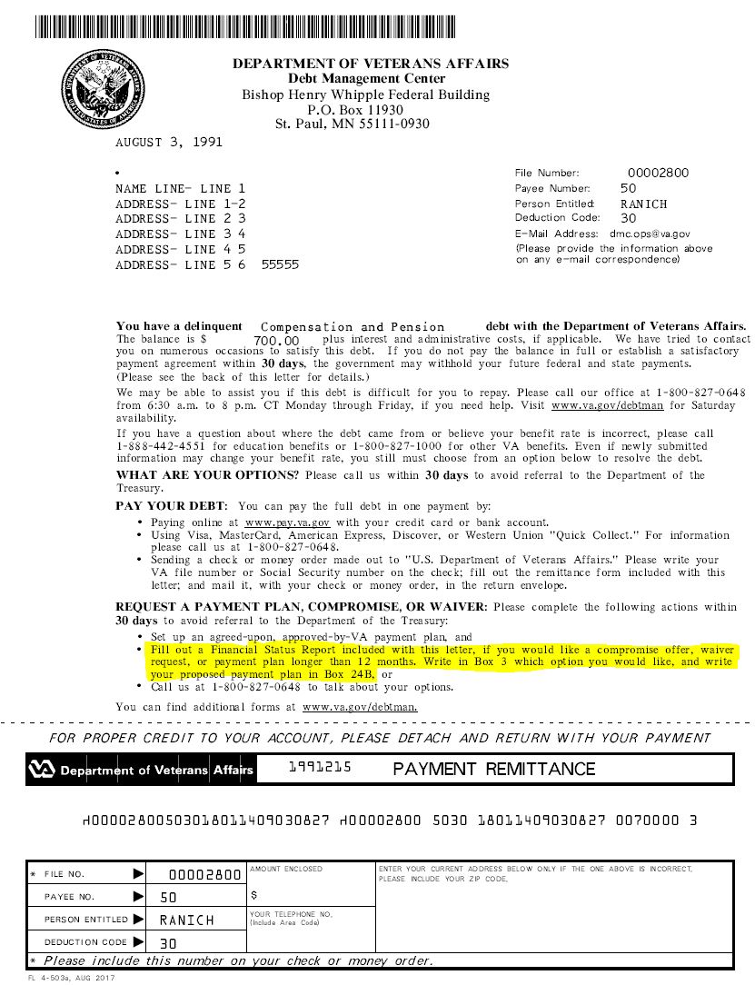
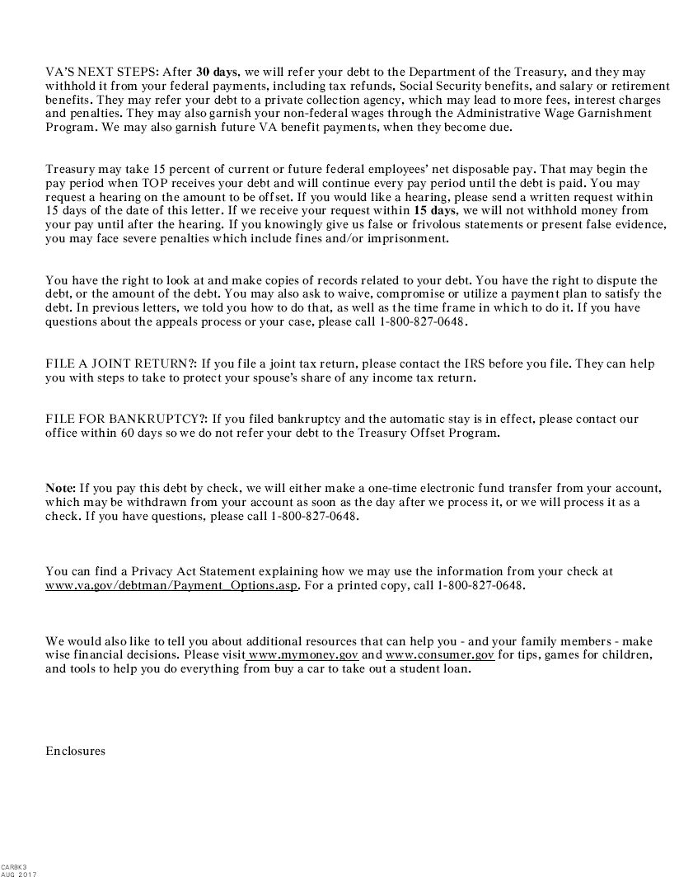
Reference of FSR Noted in 123 Letters

Slide 19
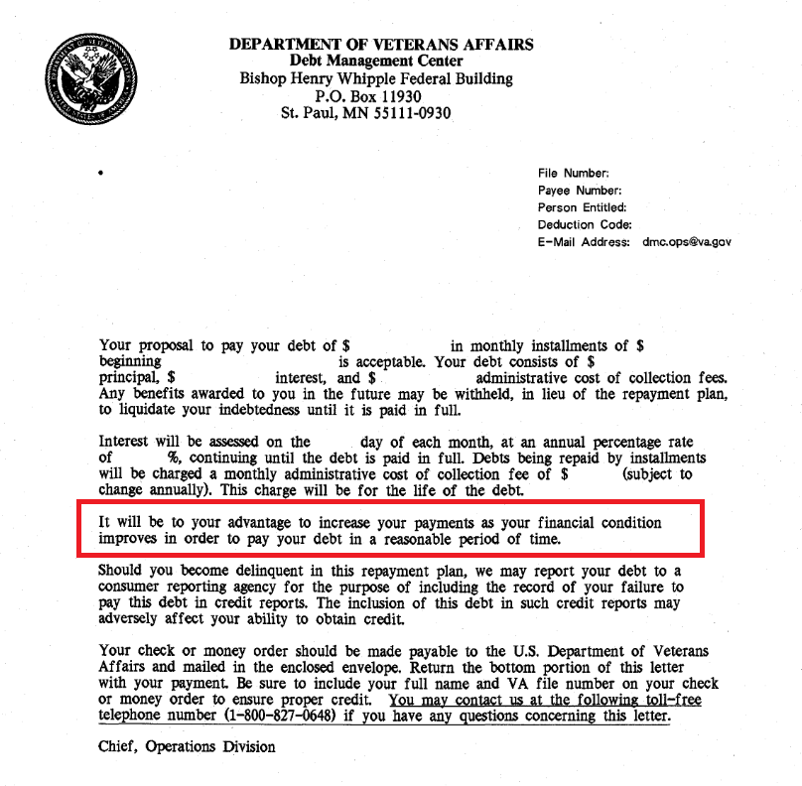
Reference of FSR Noted in 600 Letter
DMC’s 600 letter states in the third paragraph: “It will be to your advantage to increase your payments as your financial condition improves in order to repay your debt in a reasonable period of time.”
Always consider Veterans or account holders ability to pay.

Slide 20
Analyze Financial Status Report (FSR) Before Processing or Consulting with a Supervisor
Ensure there is File Number or Social Security Number on the FSR
Is the FSR completed properly? (Both pages, signature and all key point sections completed?)
Why is there a debt or account? (SHARE/VBMS/TIMS/LTS) (Drill Pay, Dependency Change, Change in school enrollment, retirement pay, incarceration, return to active duty, etc.)
Block 3 – what is being requested? (Order of consideration)
Always consider the age and size of debt as well as Veteran or account holders needs and the debts needs!
Is debtor or account holder receiving benefits? (Compensation/Pension, Education, Social Security, Drilling for Pay or Points) (Verify using SHARE & BDN)

Slide 21
Analyze Financial Status Report (FSR) Before Processing or Consulting with a Supervisor
Did debtor list all benefits as income on Block16?
Remember to be strong fiscal stewards of the money entrusted to us while aggressively advocating on behalf of Veterans
What is debtor or account holder offering to repay on monthly basis in Block 24B? (If left blank, consider it as a can’t $0 can $XXX.XX) (Do not be lasered focused on this box and do not reduce payment plan lower than what debtor asked in Block 24B). What is being offered may not be agreed upon!
Income exceeds expenses – verify the amount you calculated and what is in Block 24A (Match/Not matching).
Minimum repayment threshold is $25.00 for repayment plan of an account that is recovered in 12 months or less and $50.00 if repayment plan of an account recovery is greater than 12 months.
Payment plan request exceeding 3 years requires the collaborative support of supervisor.

Slide 22
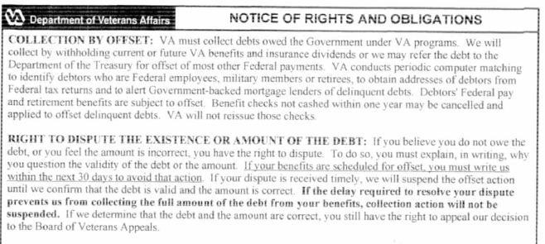
Notice of Rights and Obligations

Slide 23
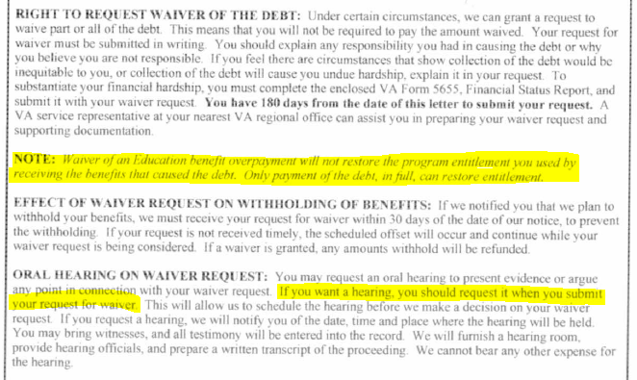
Notice of Rights and Obligations

Slide 24
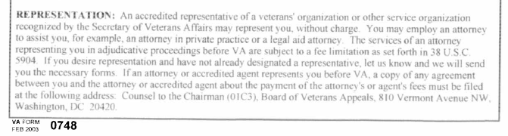
Notice of Rights and Obligations

Slide 25
Debt Management Center Mission Statement
Mission
The Debt Management Center provides Veterans and beneficiaries with compassionate counseling on their VA benefit debts. We also provide distinctive high quality accounts receivable services through a value added approach, empowering our stakeholders to focus on core mission functions.
Vision
To serve America's Veterans and stakeholders by providing world-class financial services and unparalleled resource stewardship.
Quality Policy
The Debt Management Center (DMC, the Center) provides counseling to debtors, accounts receivable services and fiscal stewardship to VA administrations and tax payers worldwide. Commitment to excellence and compassion for the Veterans is a driving force in the Mission of the Center. The Center adheres to this standard through integrity, advocacy, and respect to all stakeholders. DMC's policy is to provide services to meet federal requirements for debt collection and mitigate fraud, waste, and abuse. DMC leadership is responsible for control and sustainment of the Quality Management System by reviewing, monitoring, and communicating standards. DMC is committed to achieving customer satisfaction measured through stakeholder input.

Slide 26
Questions?

